Slide 1


Slide 2


A brief recap on themes
Made by a student of group number: PI24-2v Oblachkov D.A.

Slide 3

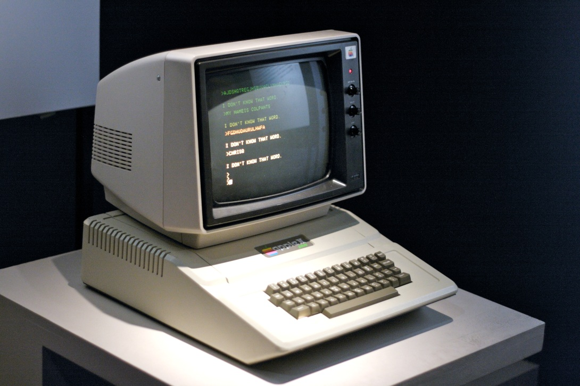
Inside a PC
1) Hardware 2) Operating system 3) Utility or application software 4) Open-Source or perpetual license 5) Types of computers

Slide 4
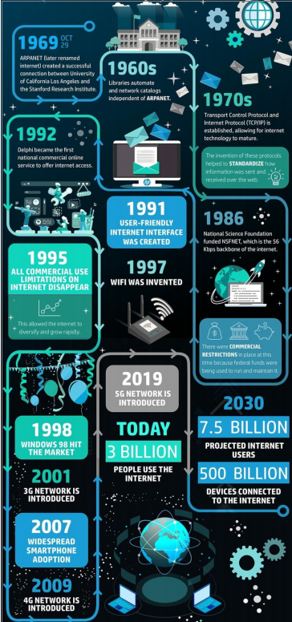

The Internet
1) History of internet 2) What is Internet and how it works? 3) Web browsers 4) Search engines

Slide 5
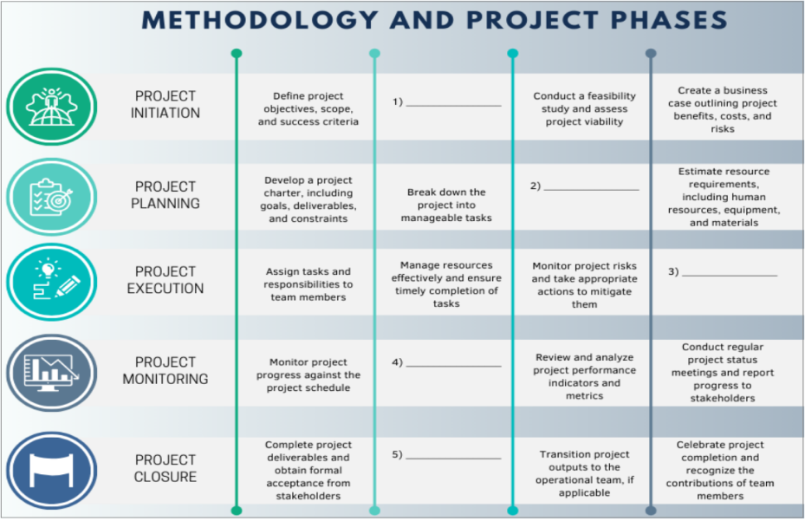
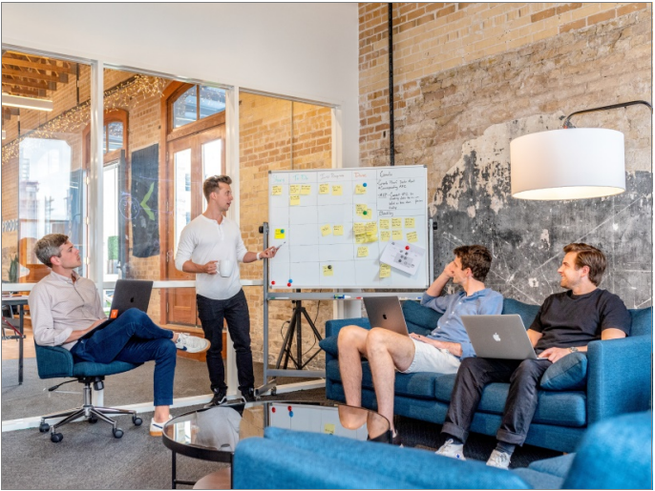
Project management in IT
1) Agile or waterfall methodology 2) Main milestones of an IT project 3) What characteristics and skills should a good project manager have?

Slide 6

BIG DATA
1) The five V’s of Big data:
- Velocity - Volume - Value - Variety - Veracity 2) Where the Big Data can come in handy?

Slide 7
That’s all folks!
Thank you for your attention!

